Slide 1
Generator’s modification of EGVSR model
Damiano Giani
Exam:Visual And Multimedia Recognition
Professor:Alberto Del Bimbo

Slide 2
Video Super Resolution
Video super resolution (VSR) aims to generate high quality videos from low quality videos by avoiding the creation of noises and blur effects, which are usually caused by techniques based on interpolation algorithms.
In this project has been performed VSR on football’s video using two modifications of the generator of EGVSR model.
Visual And Multimedia Recognition
Notes:
Interpolazione bicubica

Slide 3
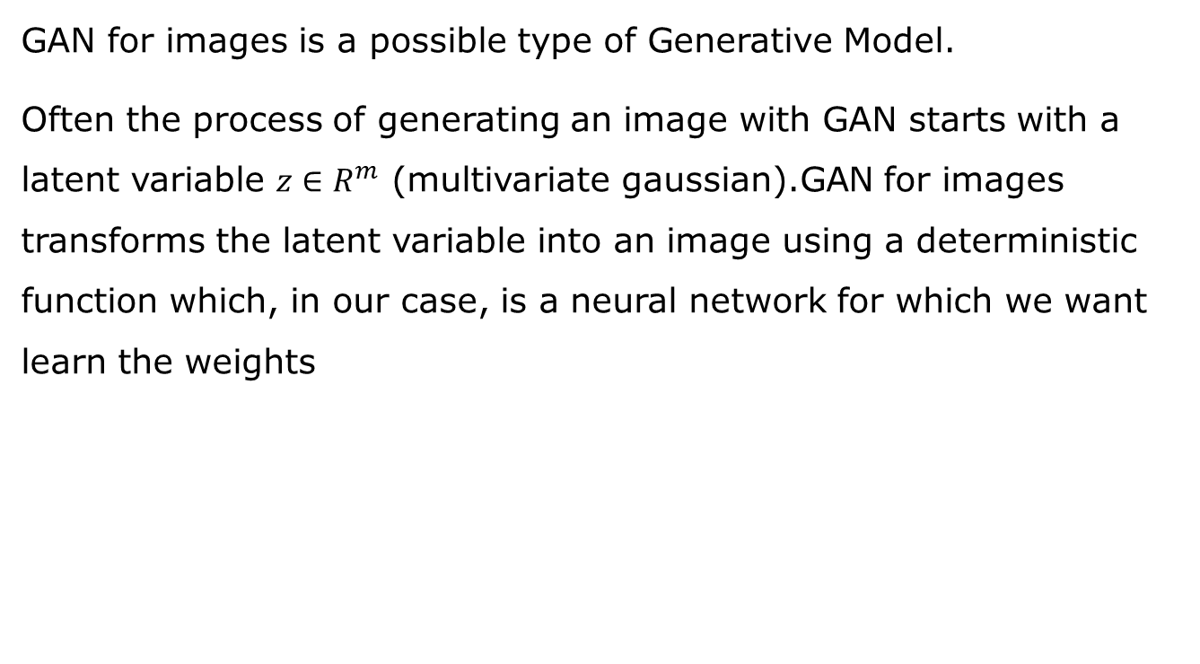
General Adversarial Network(GAN)
GAN for images is a possible type of Generative Model.
Often the process of generating an image with GAN starts with a latent variable $z∈R^{m}$ (multivariate gaussian).GAN for images transforms the latent variable into an image using a deterministic function which, in our case, is a neural network for which we want learn the weights
Visual And Multimedia Recognition

Slide 4
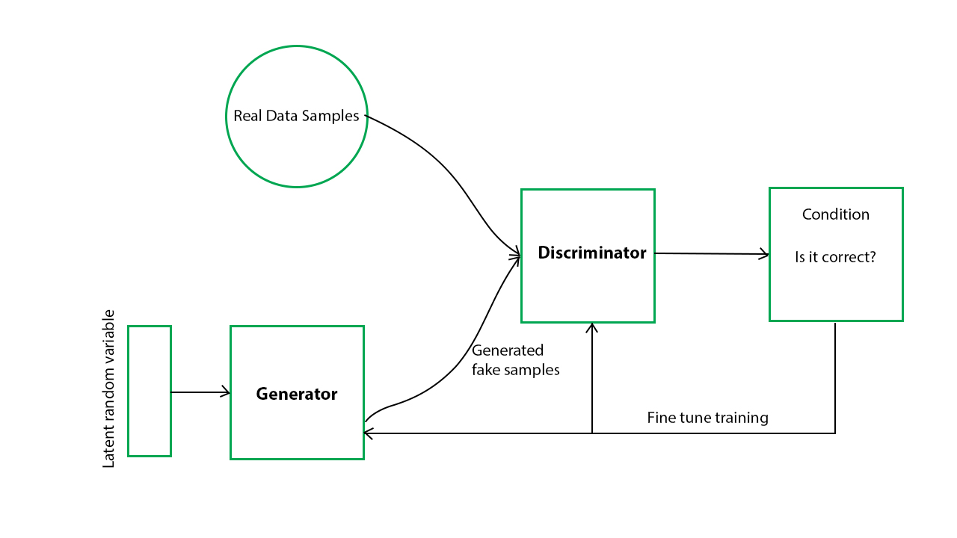
GAN architecture
GAN consists of two modules. The Generator, whose purpose is to generate new images, and the Discriminator whose purpose is to recognize false images. The key to achieve the goal of generating real-looking images is to perform competitive-training between Generator and Discriminator.
Visual And Multimedia Recognition

Slide 5
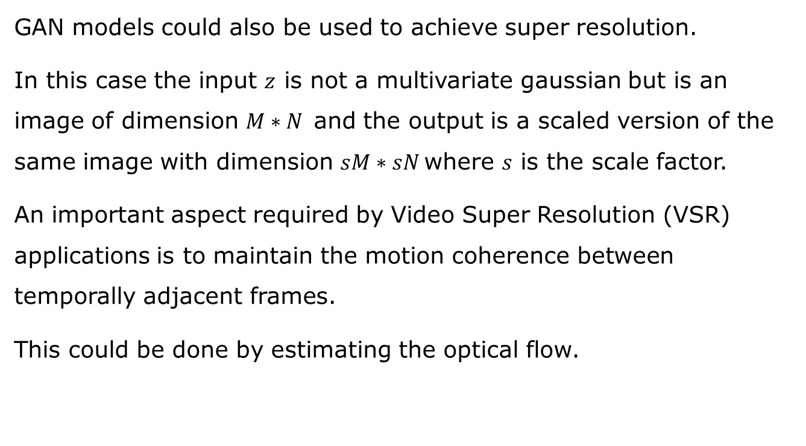
GAN for Super Resolution
GAN models could also be used to achieve super resolution.
In this case the input $z$ is not a multivariate gaussian but is an image of dimension $M∗N$and the output is a scaled version of the same image with dimension $sM∗sN$where $s$ is the scale factor.
An important aspect required by Video Super Resolution (VSR) applications is to maintain the motion coherence between temporally adjacent frames.
This could be done by estimating the optical flow.
Visual And Multimedia Recognition

Slide 6
Efficient and Generic VSR System (EGVSR)
In this project has been modified the Generator of Efficient and Generic VSR system (EGVSR) model.
This model is based on a previous super resolution model called TecoGAN (TEmporally COherent GAN) which uses space-time informations to achieve good results in VSR.
The difference between EGVSR and TecoGAN is that former is faster and could be used in real-time application.
Visual And Multimedia Recognition

Slide 7
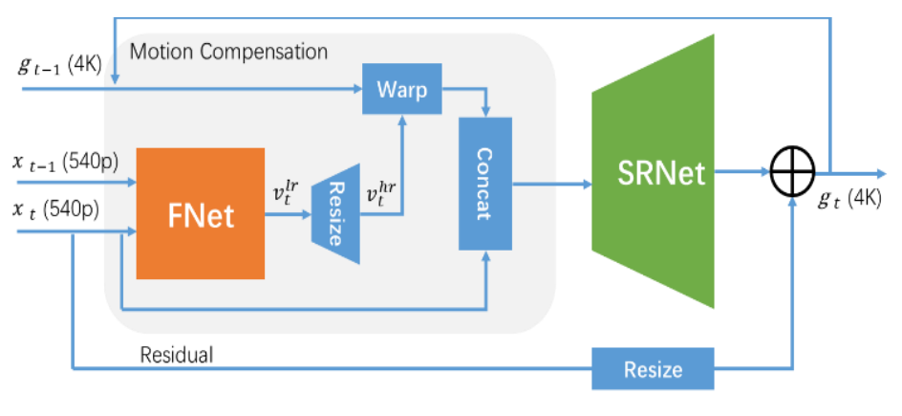
EGVSR Generator
The EGVRS generator consists of two main modules.
Visual And Multimedia Recognition

Slide 8
Fnet module
The aim of FNet is to estimate the Dense Optical Flow in order to perform a consistent frame reconstruction. Fnet has an encoder-decoder architecture.
The Encoding part uses three encoder units:
Encoder={Conv2d→LeakyReLU→Conv2d→LeakyReLU→MaxPool2}
The Decoding part uses three decoder units:
Decoder={Conv2d→LeakyReLU→ Conv2d→ LeakyReLU→ BilineraUp×2}
Visual And Multimedia Recognition

Slide 9
SRNet module
The aim of SRNet module is to perform super resolution of the low-resolution frames using the information provided by FNet.
SRNet is based on the ResNet model and uses ten ResBlock blocks:
ResBlock={Conv2d→ReLU→ Conv2d}
To perform the upsampling operation SRNet uses a convolution sub-pixel layer:
ConvSubPixel={PixelShuffle×4→ReLU→Conv2d}
Visual And Multimedia Recognition

Slide 10
Guideline of the project
The idea behind the modification of EGVSR model’s generator is to process background and foreground of each frame separately.
The optical flow should be very different between foreground and background pixels.
Therefore processing background and foreground separately, should allow the model to estimate a more consistent optical flow.
This should result in better super resolution.
Visual And Multimedia Recognition

Slide 11
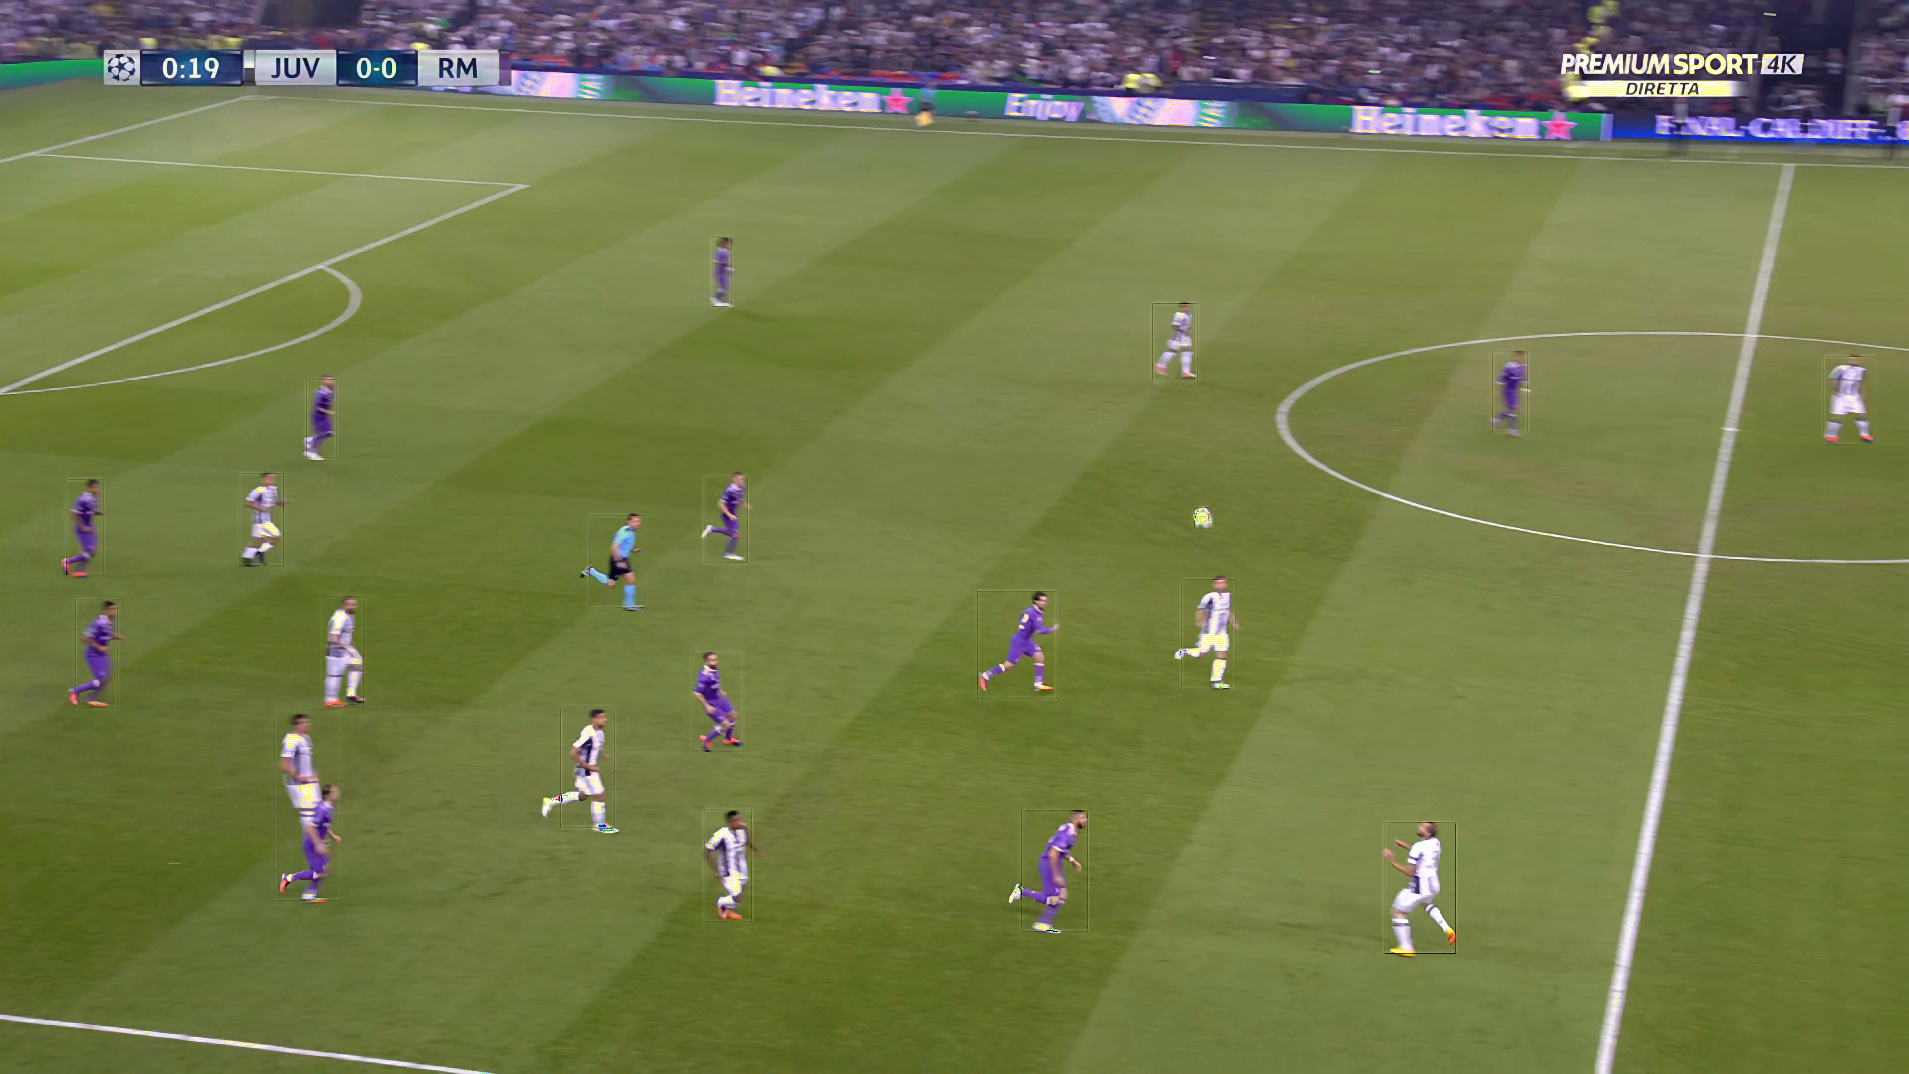
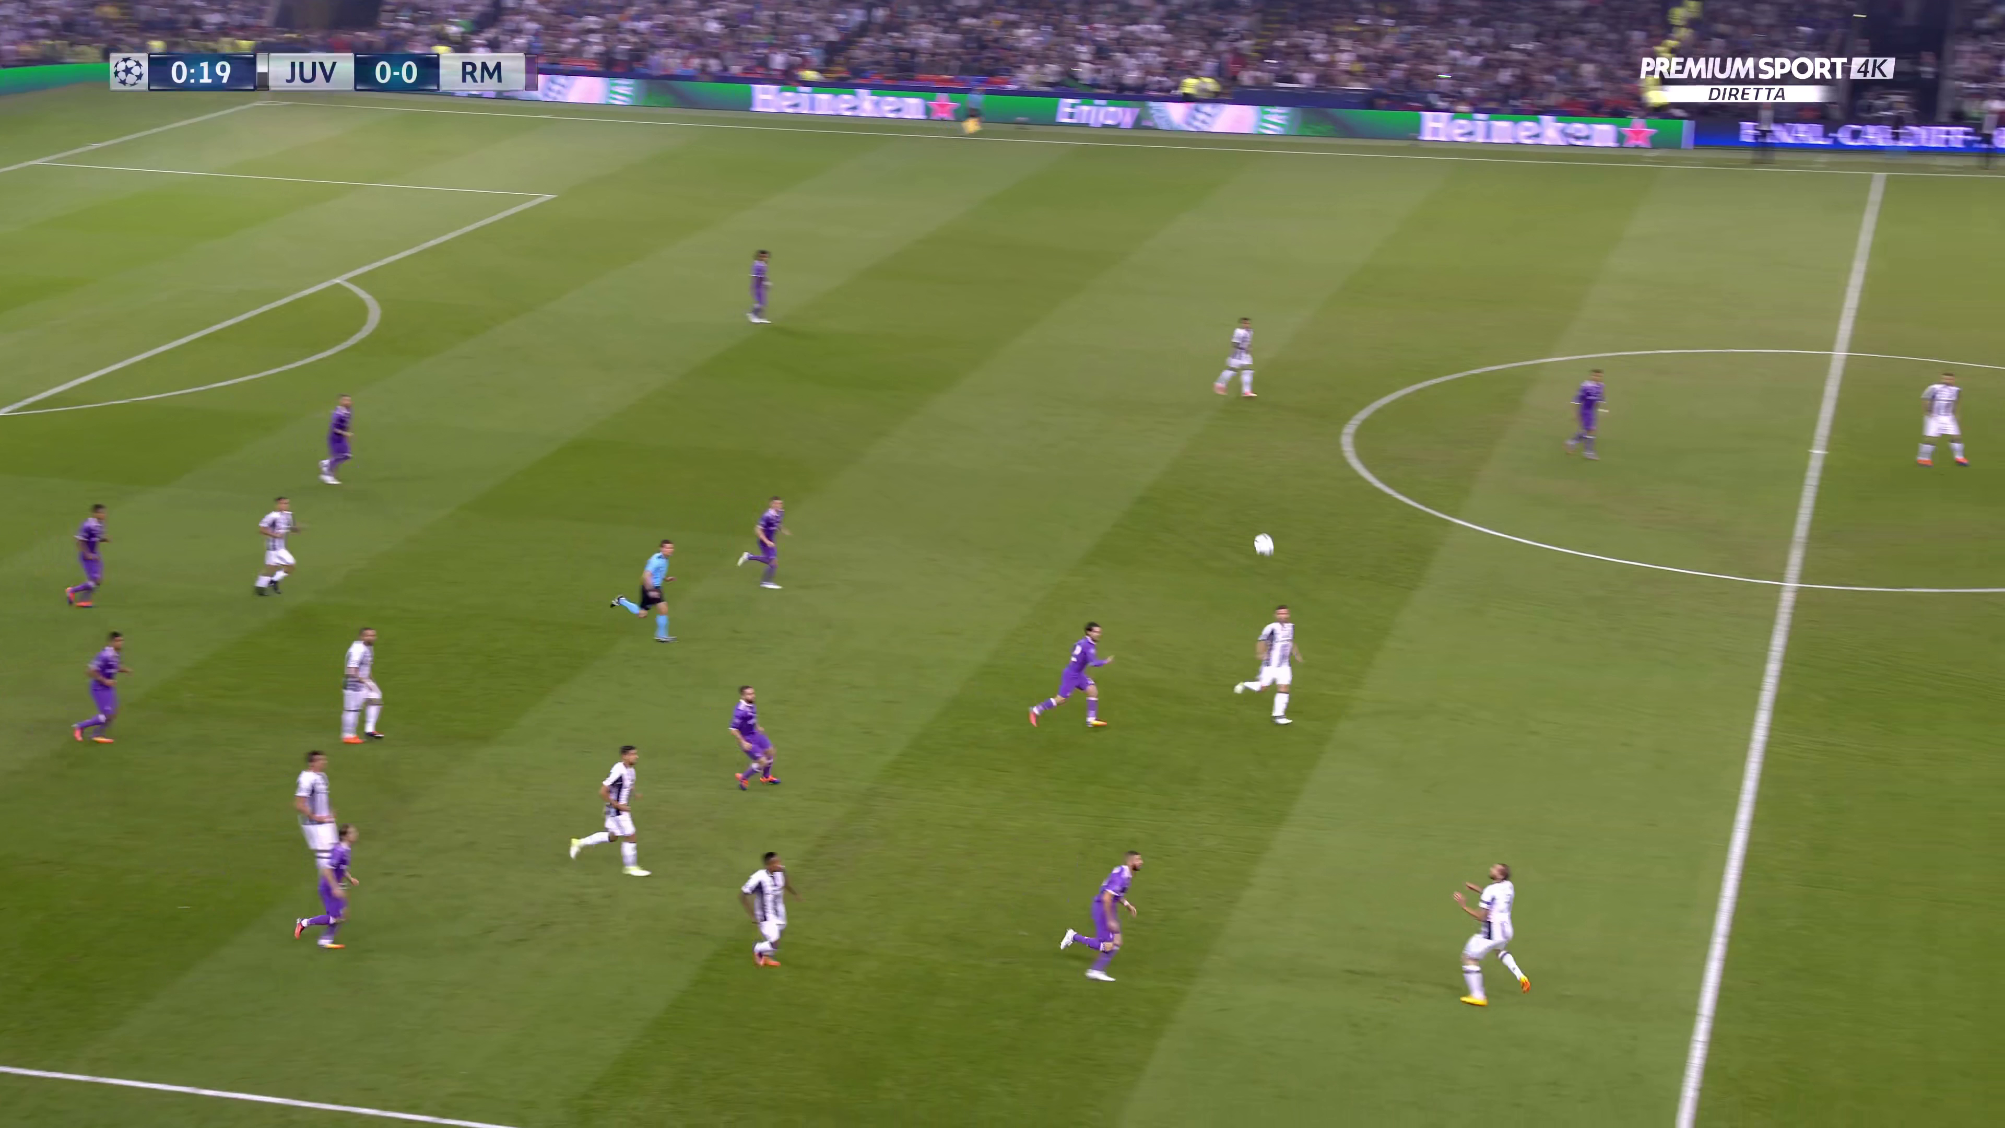
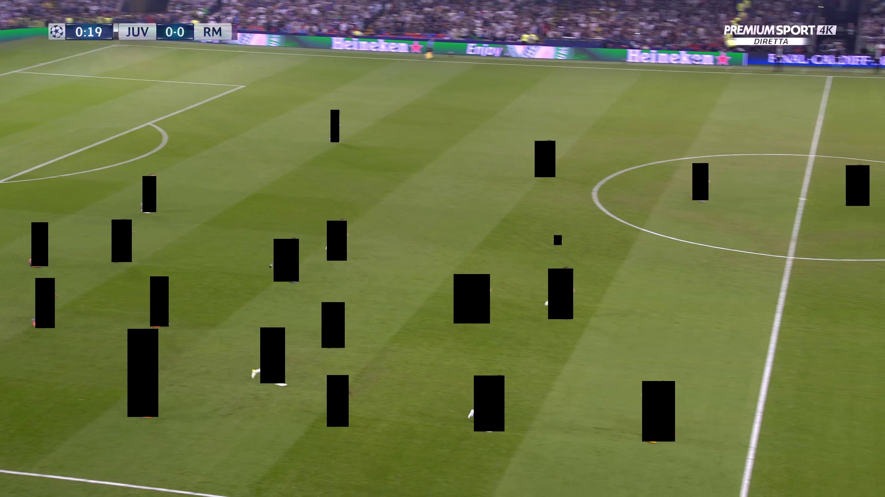
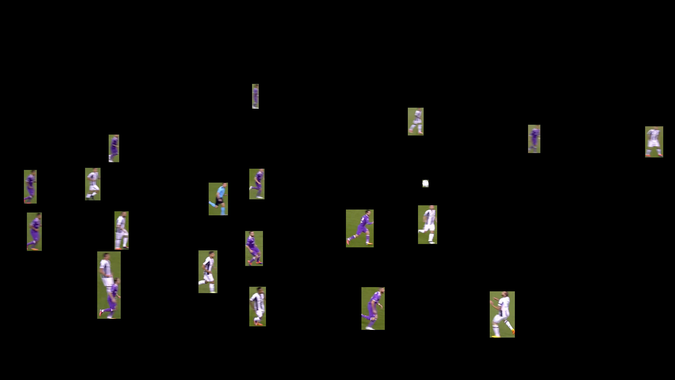
Separation of the background and foreground of the original frames
Visual And Multimedia Recognition

Slide 12
Separation of original frames in background and foreground
To separate background and foreground has been used YOLO,a detector that recognize the objects of interest and their relative bounding boxes.
Is possible to obtain the background images by setting all the pixels inside the bounding boxes to black.
To obtain the foreground pixels is sufficient to subtract the original image with the background image.
Visual And Multimedia Recognition

Slide 13
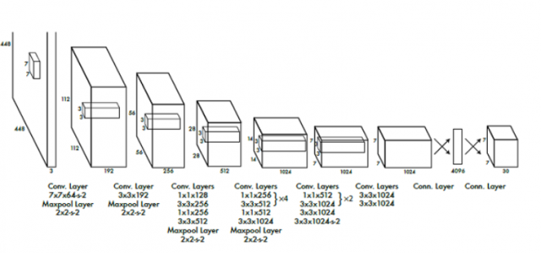
YOLO
YOLO is a single stage detector that predicts the bounding boxes and theirs class probability directly on the image using a single convolutional network.
Visual And Multimedia Recognition

Slide 14
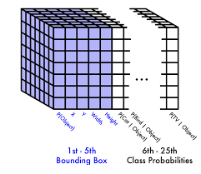
YOLO
YOLO partitions the input image into a 7*7 pixels grid and its aim is to predict a tensor containing, for each cell of the grid ,the informations about the bounding boxes and theirs class probability.
A grid cell is responsible for detecting an object if the center of the object falls inside it.
Visual And Multimedia Recognition

Slide 15
Training Process
Before modifying the model’s Generator, the EGVSR model has been trained.
To train the model has been used 4k videos of football matches from which has been extracted the frames for the ground truth and has been computed the corresponding low resolution frames.
Before starting the training process, the model has been initialized with the weights reported by the authors of the original article.
Then it has been used the same parameters and procedure of the original work to train the model.
Visual And Multimedia Recognition

Slide 16
Training Process
The learning rate value chosen to train the model is the same used by the authors and is equal to 5e-5 for both generator and discriminator.
To train the model has been used 12000 iterations, saving the model weights every 3000 iterations.
Visual And Multimedia Recognition

Slide 17
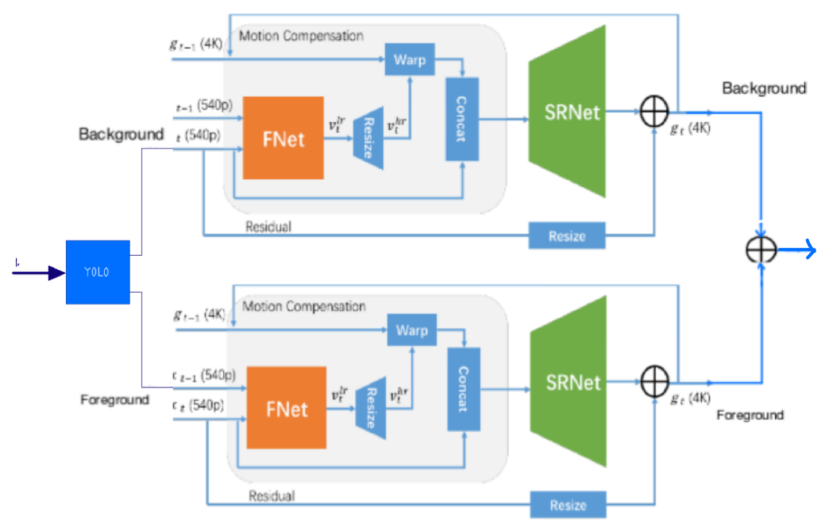
First Modification of EGVSR Generator
Visual And Multimedia Recognition

Slide 18
First Modification of EGVSR Generator
The idea of ​​the first modification is to process the background and foreground frames separately until the generation of their corresponding high resolution version is completed.
Visual And Multimedia Recognition

Slide 19
First Modification of EGVSR Generator
To obtain the entire high-resolution image, the two results are added together resulting in an overlapping background and foreground.
Visual And Multimedia Recognition

Slide 20
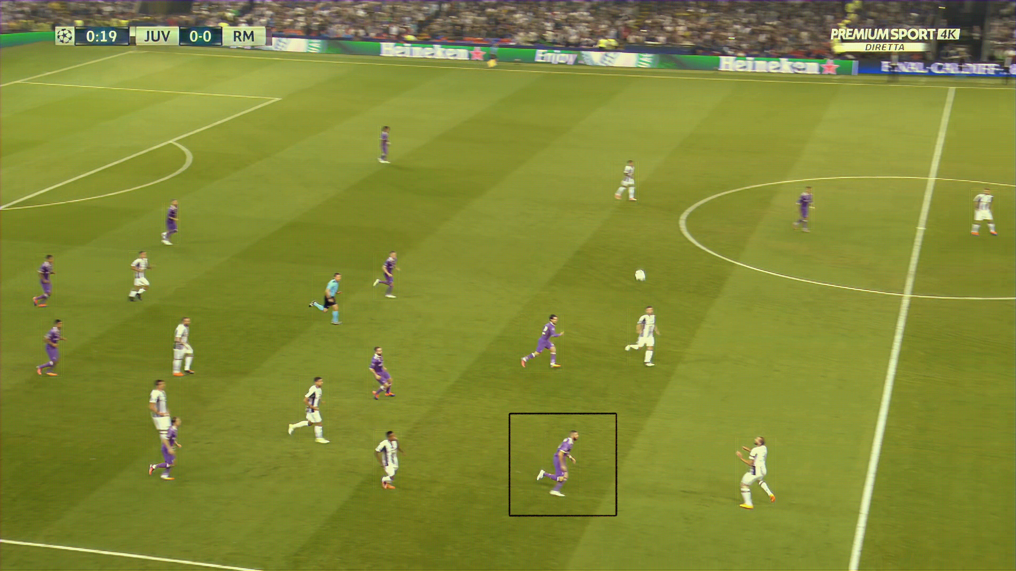

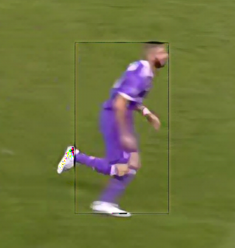
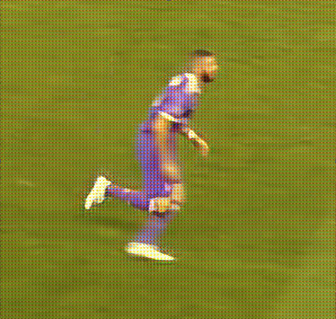
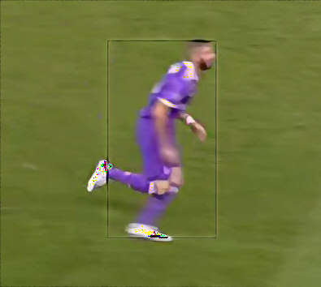

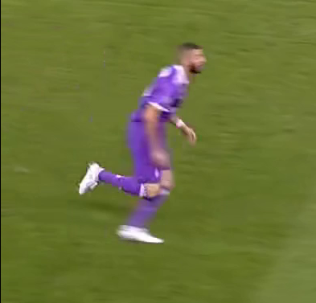
Example:Output frame of first modification
Second
Method
Baseline
Method
Visual And Multimedia Recognition

Slide 21
Example: Output video of first modification
Visual And Multimedia Recognition

Slide 22
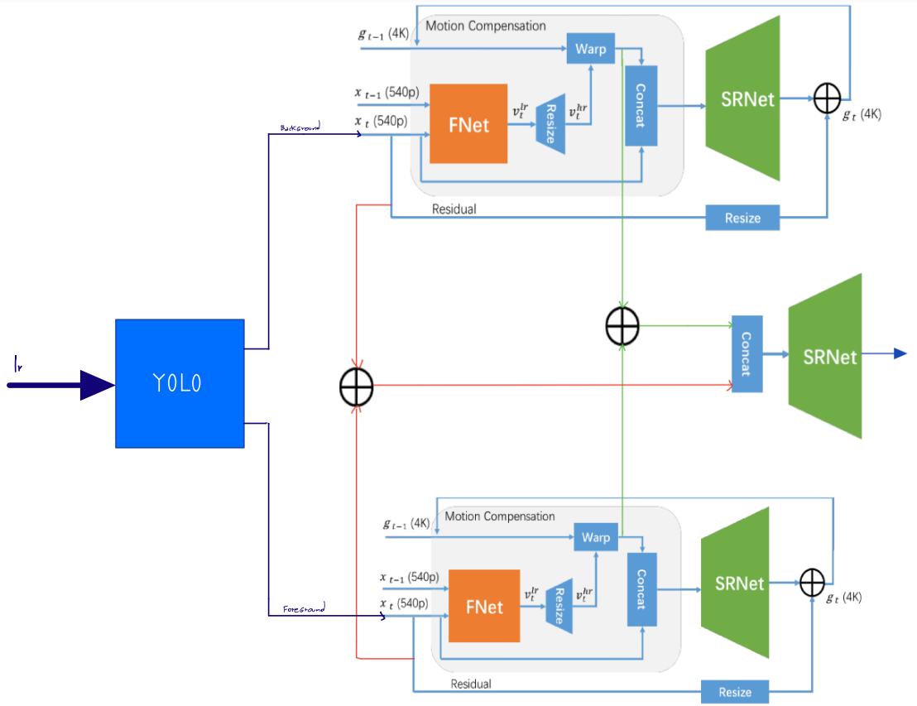
Second Modification of EGVSR Generator
Visual And Multimedia Recognition

Slide 23
Second Modification of EGVSR Generator
The second modification consists of processing the background and foreground frames separately. During this process, the optical flow of the background and of the foreground are estimated by two different FNet modules.
Visual And Multimedia Recognition

Slide 24
Second Modification of EGVSR Generator
The outputs of these two modules are than used to warp the corresponding previous high resolution frames, which are generated by two different SRNet modules.
Visual And Multimedia Recognition

Slide 25
Second Modification of EGVSR Generator
The results of the two warps are then added together and concatenated with the sum of low resolution background and foreground frames.
Visual And Multimedia Recognition

Slide 26
Second Modification of EGVSR Generator
The tensor resulting from this concatenation is finally given as input to a
third SRNet module, which generates as output the high resolution frame.
Visual And Multimedia Recognition

Slide 27


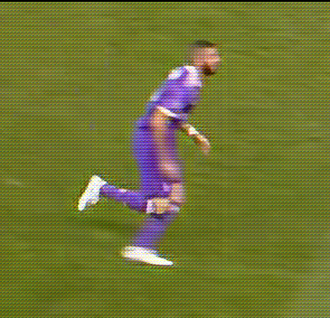
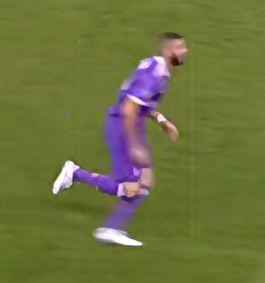
Example:Output frame of Second modification
Second
Method
Baseline
Method
Visual And Multimedia Recognition

Slide 28
Example:Output video of second modification

Slide 29
Evaluation Metrics:
PSNR (Peak Signal-to-Noise Ratio)
SSIM (Structural Similarity Index Measure)
LPIPS (Learned Perceptual Image Patch Similarity)
Visual And Multimedia Recognition

Slide 30
PSNR
Peak Signal to Noise Ratio is a measure usually adopted to evaluate the quality of a compressed image compared to the original.
This value indicates the ratio between the maximum power of a signal and the power of the noise that alters the quality of the image.
The higher the PSNR value the better the result.
Visual And Multimedia Recognition

Slide 31
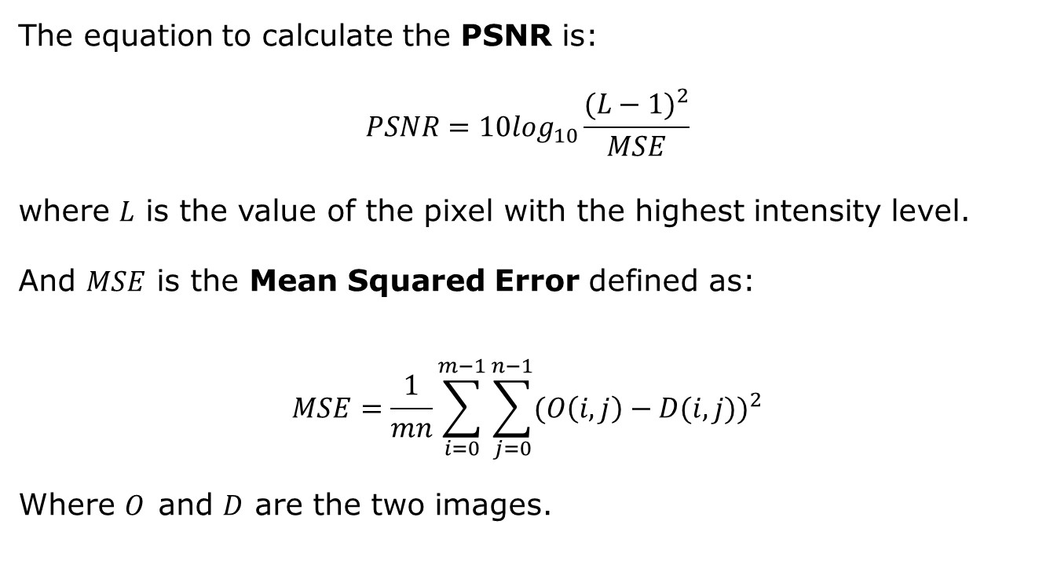
PSNR
The equation to calculate the PSNR is:
$$PSNR=10\log_{10}\frac{{(L−1)}^{2}}{MSE}$$
where 𝐿 is the value of the pixel with the highest intensity level.
And $MSE$ is the Mean Squared Error defined as:
$$MSE=\frac{1}{mn}\sum_{i=0}^{m−1}{\sum_{j=0}^{n−1}{{(O\left(i,j\right)−D(i,j))}^{2}}}$$
Where $O$and $D$ are the two images.
Visual And Multimedia Recognition

Slide 32
SSIM
Structural Similarity Index Measure is a measure to calculate the perceptual quality of digital images.
SSIM estimates the degradation of an image compared to the original image by analyzing the changing in the structural, luminance and contrast information.
The higher the SSIM value the better the result.
Visual And Multimedia Recognition

Slide 33
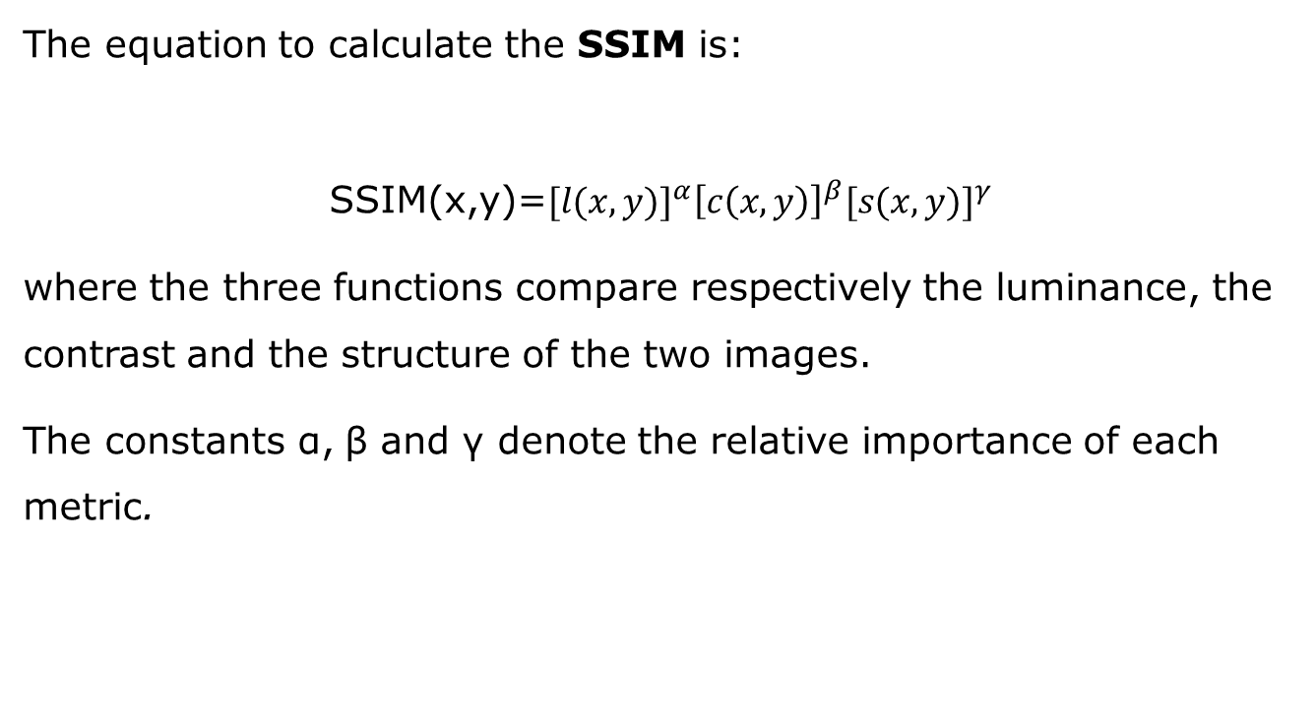
SSIM
The equation to calculate the SSIM is:
$$\text{SSIM}\text{(}\text{x}\text{,}\text{y}\text{)=}{[l(x,y)]}^{α}{\left[c\left(x,y\right)\right]}^{β}{[s(x,y)]}^{γ}$$
where the three functions compare respectively the luminance, the contrast and the structure of the two images.
The constants α, β and γ denote the relative importance of each metric.
Visual And Multimedia Recognition

Slide 34
LPIPS
Learned Perceptual Image Patch Similarity is used to measure the percentage of similarity between two images.
To calculate this value, the two images are given as input to a model that compares the image patches.
Lower values means more similar images.
This image analysis method was introduced in 2018 by Richard Zhang et al.
This measure has been shown to match human perseption well.
Visual And Multimedia Recognition

Slide 35
Results:
The previously described metrics were calculated both on the whole frame and on the foreground patches.
The later was done in order to evaluate eventual benefit of the modifications in reconstructing the foreground’s details.
The evaluation include also the processing times of the baseline and of the two modification.
Visual And Multimedia Recognition

Slide 36
Metrics Result:
Evaluation Metric | Baseline | Method1 | Method2
Full Frame | Full
PSNR | 29.605 | 28,260 | 29.655
SSIM | 0.940 | 0,930 | 0.944
LPIPS | 0.0162 | 0,043 | 0.017
Foreground Frame
PSNR | 25.192 (-14.9%) | 24.359 (-13,8%) | 25.394 (-14.37%)
SSIM | 0.841 (-10.5%) | 0.812 (-12,6%) | 0.846 (-10,3%)
LPIPS | 0.040 (-146.92%) | 0.042 (+2,33%) | 0.045 (-164,7%)
Visual And Multimedia Recognition

Slide 37
Time processing
Image Dimension | Baseline | Method1 | Method2
3840x2160 | 23.41s | 66,42s | 93,66s
1280x720 | 5.53s | 15,75s | 22.67s
Visual And Multimedia Recognition

Slide 38
Conclusion
The results obtained by analyzing the frames generated by the first modification were lower than the results obtained using the baseline.
Second modification improves the results about PSNR and SSIM compared to the baseline.
In terms of processing times, the first modification required three times the time needed by the baseline. The second modification required four times the time needed by the baseline.
The first modification improves its foreground results related to LPIPS compared to its full frame.
Visual And Multimedia Recognition

Slide 39
Bibliography
Original EGVSR Model
project code
YOLOv5
YOLO
LPIPS
TecoGAN
Visual And Multimedia Recognition

Slide 40
EGVSR Discriminator
The first layer is a convolutional layer,followed by a discriminator block.
The discriminator block is made of 4 block:
block={Conv2d→BatchNorma2d→LeakyReLU}
The discriminator block perform a downsample 16x
Finally the last layer is a dense layer which perform the classification
Visual And Multimedia Recognition
Notes:
Dopo convolutional c’è una LeakyRelu

Slide 41
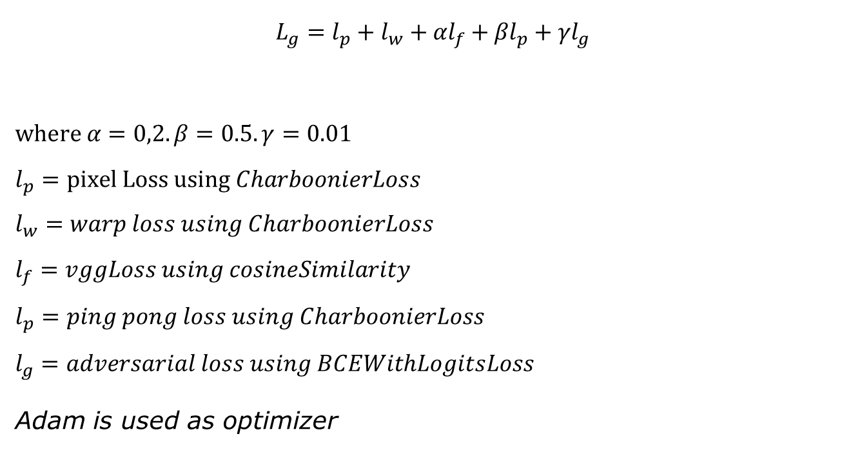
Generator’s loss function:
$$L_{g}=l_{p}+l_{w}+{αl}_{f}+{βl}_{p}+γl_{g}$$
$$where α=0,2. β=0.5. γ=0.01$$
$$l_{p}=pixel Loss using CharboonierLoss$$
$$l_{w}=warp loss using CharboonierLoss$$
$$l_{f}=vggLoss using cosineSimilarity$$
$$l_{p}=ping pong loss using CharboonierLoss$$
$$l_{g}=adversarial loss using BCEWithLogitsLoss$$
Adam is used as optimizer
Visual And Multimedia Recognition
Notes:
Charbonnier loss is a mix between the L1 and L2 loss.Similarità coseno è il prodotto scalare fratto modulo dei due..calcola angolo fra due vettori di feature.
charbonierLoss
diff = x – y element-wise loss = torch.sqrt(diff * diff + self.eps) poi ritorna la media dei valori nei tensori.
Sigmoide va da 0 a 1 e al logaritmo diamo la sigmoide xn è la prob che s sia reale stimata dal discriminatore yn è reale.
ℓ(x,y)=L={l1​,…,lN​}⊤, ln​=−wn​[yn​⋅logσ(xn​)+(1−yn​)⋅log(1−σ(xn​))] questa è la bcewith logist e poi si fa la media
In uscita dal discriminatore c’è un dense con 1 che ci dice vera o falsa.

Slide 42
Training Process
BCEWithLogitsLoss
Pixel loss compara GT data e hr data quindi differenza fra immagini
Warp loss compara lr current e lr warp per vedere se il warp funziona
Feature loss compara le feature GT e HR estratte da vgg19 dai alcuni layer
Ping-Pong loss to improve the long-term temporal consistency. It effectively prevents recurrent networks from accumulating artifacts temporally without depressing detailed features. Gli hr data sono confrontati con la loro versione temporalmente invertita
Adversarial loss è quella normale binarycrossentropy che massimizza i veri e minimiazza i falsi
Visual And Multimedia Recognition
Notes:
La funzione che si chiama foward_sequence viene utilizzata nel train perché serve calcolare tutta la sequenza direttaemente allo scopo di calcolarsi la loss. Ad esempio pixel loss non la fa su una sola foto ma su serie di immagini. Ping pong loss su tutta sequenza di immagini scambiate di ordine.
Warp compara comunque le immagini

Slide 43

Discriminator’s loss function:
BCEWithLogitsLoss
$$L_{d}=l_{fake}+l_{true}$$
$$l_{fake}=adversarialLoss using BCEWithLogitsLoss on fake image$$
$$l_{true}=warp loss using BCEWithLogitsLoss on GT image$$
$$\text{Adam} \text{is} \text{used} \text{as} \text{optimizer}$$
Visual And Multimedia Recognition

